Slide 1




DIGITAL PORTFOLIO
NAME :DHANUSHMATHI.B
REGISTER NUMBER :2422K0244
NM ID :asbru172422k0244
DEPARTMENT :BSC(CS)
COLLEGE :SRI VASAVI COLLEGE SELF FINANCE WING
BHARATHIAR UNIVERSITY

Slide 2
PROJECT TITLE
My Bio Data

Slide 3

AGENDA
1.Problem Statement
2.Project Overview
3.End Users
4.Tools and Technologies
5.Portfolio design and Layout
6.Features and Functionality
7.Results and Screenshots
8.Conclusion
9.Github Link

Slide 4
PROBLEM STATEMENT
"Nowadays, students and professionals often face difficulties in presenting their biodata in a clear and attractive way. Traditional paper biodata or resumes are limited, easily misplaced, and do not highlight skills interactively. A biodata website solves this problem by providing a digital platform to showcase personal information, education, skills, and achievements in an organized and accessible manner. It allows others, such as employers, teachers, or friends, to easily view and understand

Slide 5

PROJECT OVERVIEW
Creating Web page in digital portfolio
to bio data.Using the language
HTML CSS JavaScript .

Slide 6
WHO ARE THE END USER
All the user and humans
are the end user.

Slide 7

TOOLS AND TECHNIQUES
●Digital portfolio
●visual basic stdio
●Code pee
●HTML
●CSS
●Javascript

Slide 8
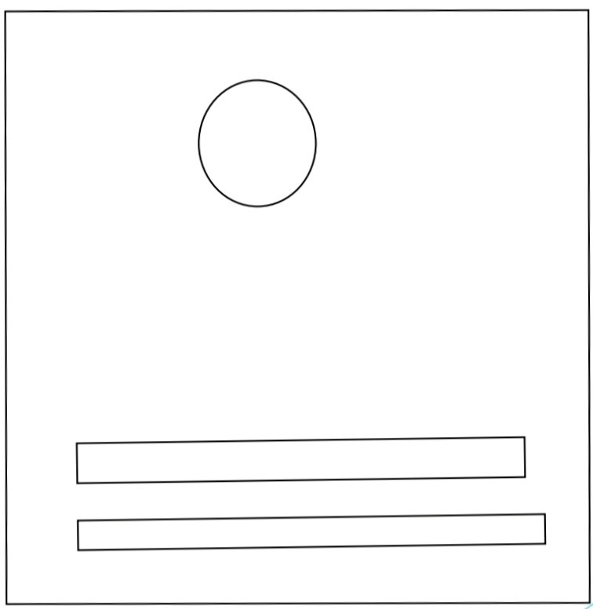
POTFOLIO DESIGN AND LAYOUT

Slide 9
FEATURES AND FUNCTIONALITY
Features of Biodata Website
User-friendly Interface – Simple and clean design for easy navigation.
Personal Information Section – Displays name, photo, contact details, etc.Features of Biodata Website
Facilities of Biodata Website
Provides a digital platform for presenting biodata.
Accessible anytime, anywhere via the internet.

Slide 10
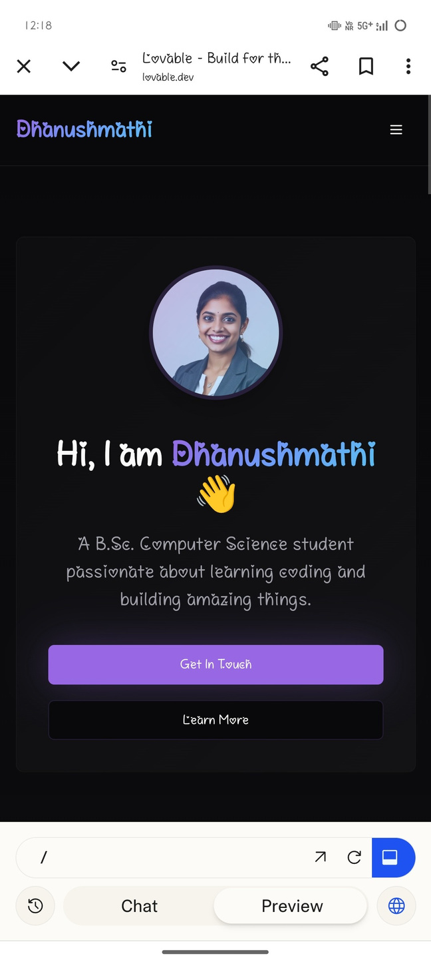

RESULTS AND SCREENSHOTS

Slide 11
CONCLUSION
In conclusion, the biodata website provides a simple and effective platform to present personal, educational, and professional details in a well-organized manner. It eliminates the limitations of traditional paper resumes and makes information easily accessible anywhere, anytime. By showcasing skills, achievements, and contact details digitally, the website not only improves self?presentation but also creates a professional 11

